Slide 2

































































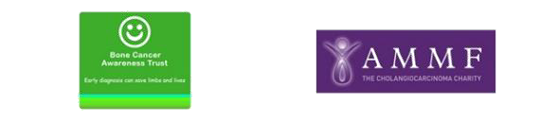












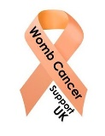











Who we are – nearly 100 members
Nearly 40% of our members have an income stream of less than £200,000; two-thirds have an income of less than £1m
Nearly 300 types of cancer are covered by our members
The majority of our members are small patient support group charities

Slide 3
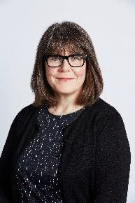
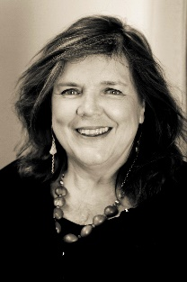
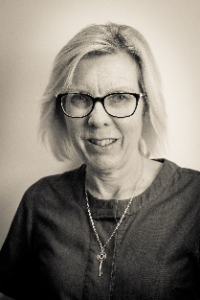
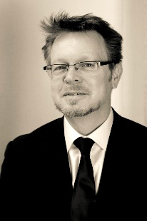
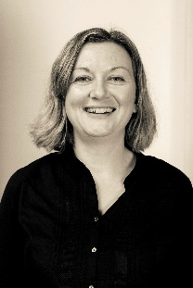
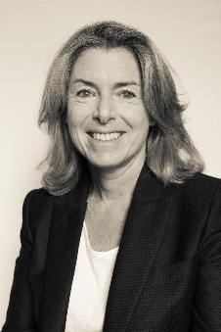
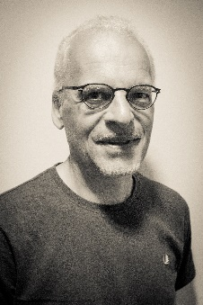
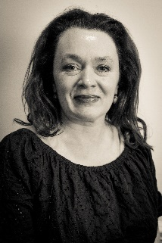
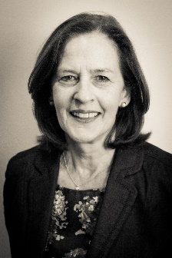
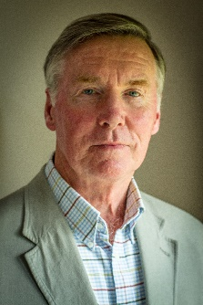
The leadership team
Our leadership team comprises policy experts, CEOs of member charities
and people affected by rare and less common cancers
Baroness Morgan of Drefelin Honorary President Cancer52
Chief Executive Breast Cancer Now
Jane Lyons CEO Cancer52
Helen Jameson
Jonathan Pearce Chair Cancer52
Sasha Daly
Vice Chair Cancer 52
Chair Debbie Fund
CEO Lymphoma Association
Head of Policy Teenage Cancer Trust
Allyson Kaye MBE
Chair Ovarian Cancer Action
Dave Ryner
Chronic Myeloid Leukaemia Support Group UK
Rebecca Porta
CEO Orchid Cancer Appeal
Helen Morement CEO AMMF The
Cholangiocarcinoma Charity
John Symons
Cancer of Unknown Primary (CUP) Foundation – Jo’s Friends

Slide 4
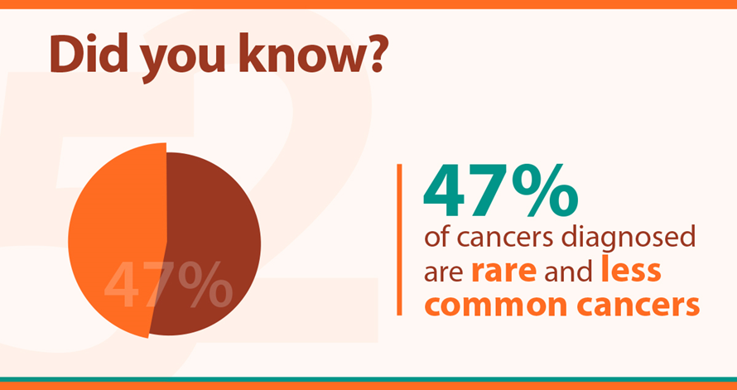
The numbers
The numbers

Slide 5
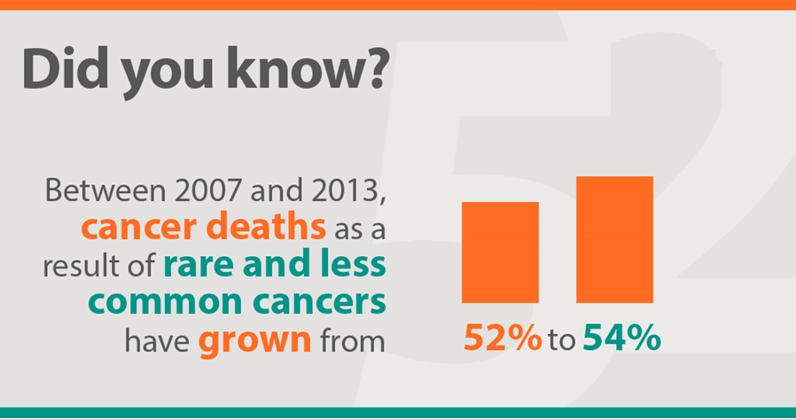
The numbers

Slide 6
Working with Cancer52
Cancer52 represents nearly 100 charities and patient organisations working in the field of rare and less common cancers, covering all aspects of cancer information, support, care and research
We work to ensure that the voice of people with rare and less common cancers is heard at a national level amongst policy makers and influencers and that strategies are implemented
Our key asset and offer to Cancer Alliances is to signpost, introduce or help facilitate new partnerships or information exchange between Alliances and a particular charity with specific expertise
We absolutely recognise the importance of Cancer Alliances in delivering on the Cancer Strategy and will do our best to support that work through bringing Alliances and our members together
Our door is wide open to assist Alliances
http://www.cancer52.org.uk/supporting-cancer-alliances-2/ info@cancer52.org.uk

